Slide 1

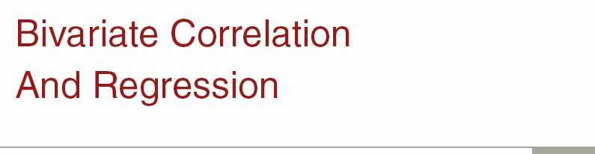
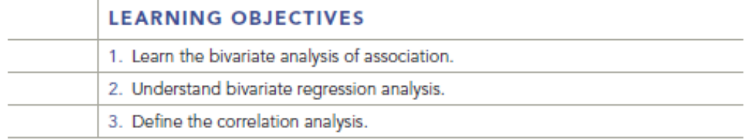
Chapter Seventeen
17-1

Slide 2

Bivariate Analysis of Association
Bivariate Techniques:
  Statistical methods of analyzing the relationship between two variables.
Independent Variable:
  Variable believed to affect the value of the dependent variable.
17-2
Key Terms & Definitions

Slide 3
Bivariate Analysis of Association
Dependent Variable:
  Variable expected to be explained or caused by the independent variable.
Bivariate Regression Analysis:
  The analysis of the strength of the linear relationship between variables when one is considered the independent variable and the other is the dependent variable.
17-3
Key Terms & Definitions

Slide 4
Scatter Diagram
Scatter Diagram:
Graphic plot of the data with dependent variable on the Y (vertical) axis and the independent variable on the X (horizontal) axis. Shows the nature of the relationship between the two variables, linear or nonlinear.
17-4
Key Terms & Definitions
Notes:
Examples of these are on the next slide.

Slide 5
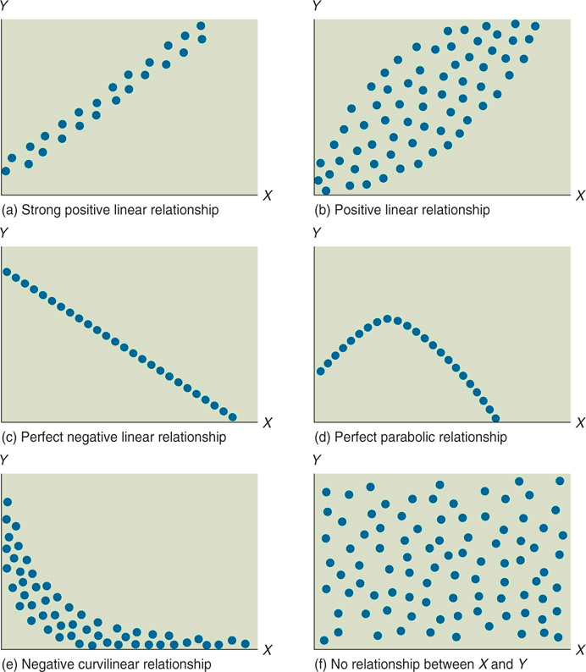
Types of Relationships Found in Scatter Diagrams
17-5
Key Terms & Definitions
Notes:
a relationship does not mean a cause and effect relationship.

Slide 6
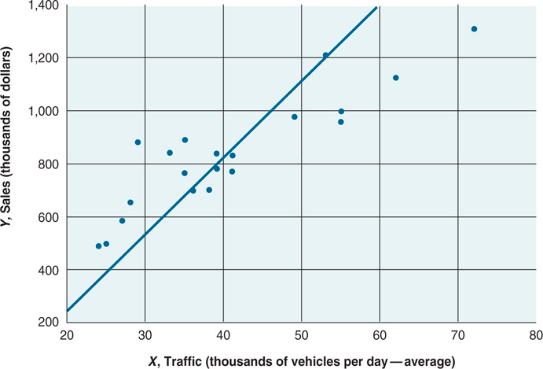
Types of Relationships Found in Scatter Diagrams
17-6
Key Terms & Definitions

Slide 7
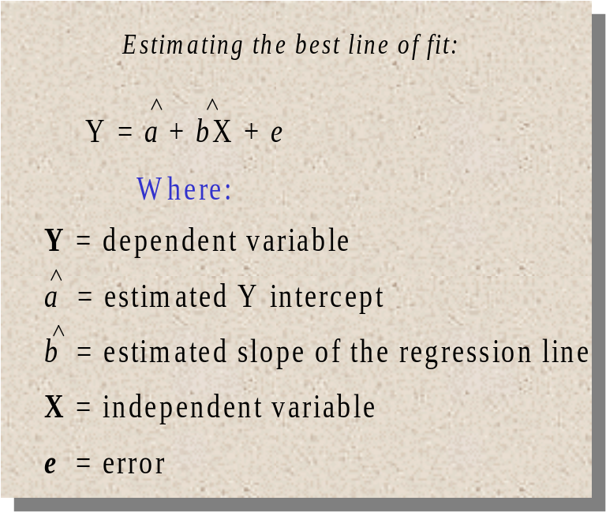
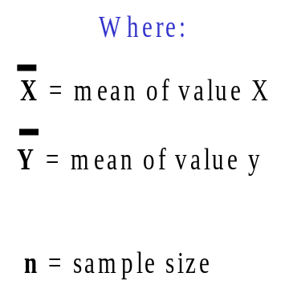
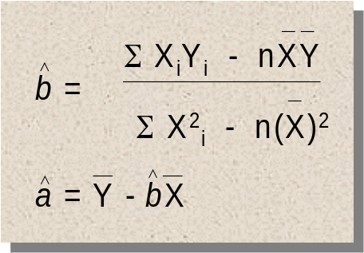
Least-Squares Estimation Procedure
Values for “a” and “b” can be calculated as follows:
17-7
Key Terms & Definitions

Slide 8
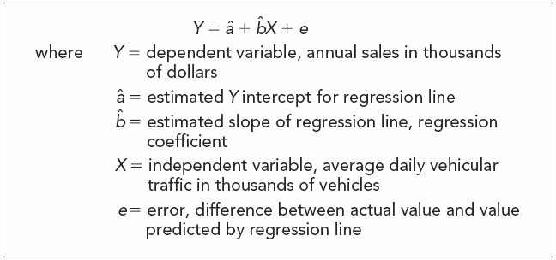
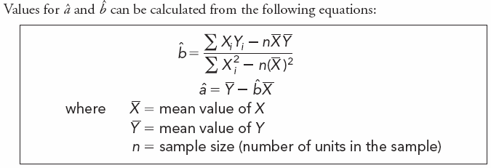
Least-Squares Estimation Procedure
The least-squares procedure is a fairly simple mathematical technique that can be used to fit data for X and Y to a line that best represents the relationship between the two variables.
17-8
Key Terms & Definitions

Slide 9
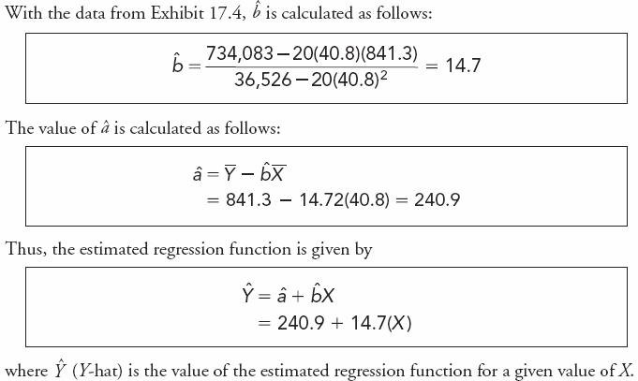
Least-Squares Estimation Procedure
The least-squares procedure is a fairly simple mathematical technique that can be used to fit data for X and Y to a line that best represents the relationship between the two variables.
17-9
Key Terms & Definitions

Slide 10
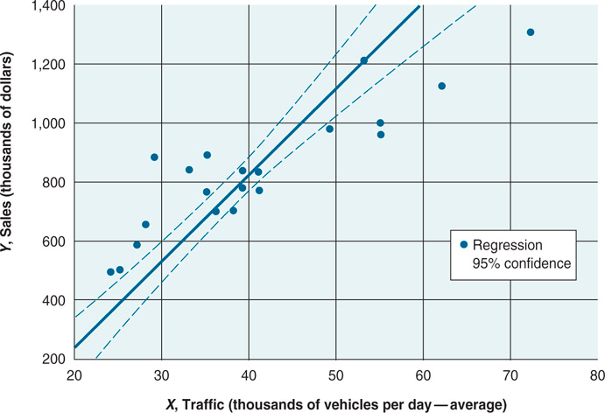
Coefficient of Determination
17-10
Key Terms & Definitions
Notes:
Refer to the text for details of the study.

Slide 11
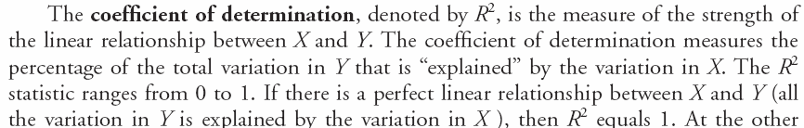
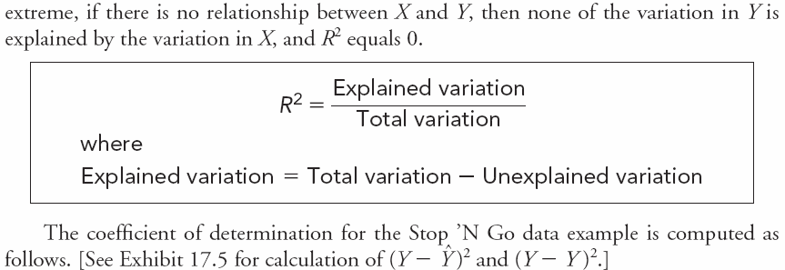
Coefficient of Determination
17-11
Key Terms & Definitions
Notes:
The data for the Stop ‘N Go study is in the text.

Slide 12

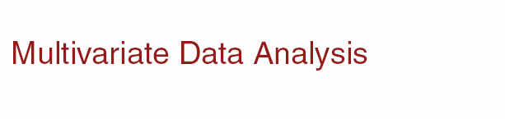
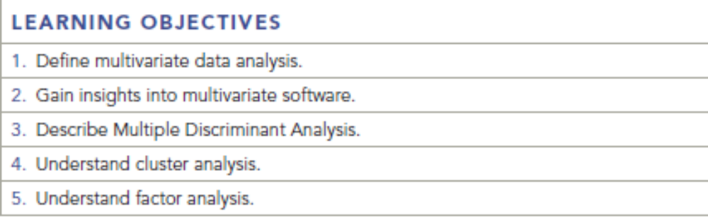
Chapter Eighteen
18-1

Slide 13
Multivariate Analysis
A general term for statistical procedures that simultaneously analyze multiple measurements on each individual or object under study.
Multivariate Regression Analysis
Multiple Discriminant Analysis
Cluster Analysis
Factor Analysis
Conjoint Analysis
18-2
Key Terms & Definitions

Slide 14
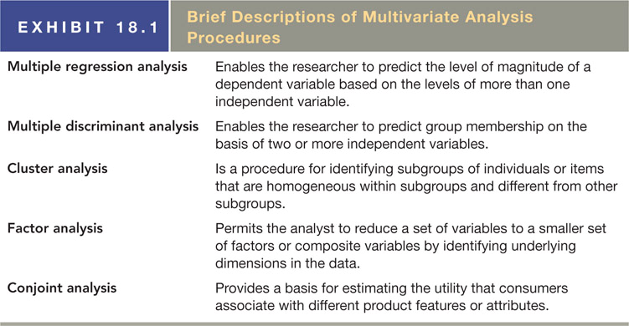
Multivariate Analysis
18-3
Key Terms & Definitions

Slide 15
Multiple Regression
Key Concepts
A procedure for predicting the level or magnitude of a (metric) dependent variable based on the levels of multiple independent variables.
Coefficient of Determination:
  Measured changes in the dependent and independent variables.
Regression Coefficients:
  Effect of the independent variable on the dependent variable.
Dummy Variables:
  They're nominally scaled variables included in regression analysis.
18-4
Key Terms & Definitions

Slide 16
Multiple Regression
Key Concepts
A procedure for predicting the level or magnitude of a (metric) dependent variable based on the levels of multiple independent variables.
Dummy Variables:
They're nominally scaled variables included in regression analysis.
An example of a dummy variable for a measure of location of birth would be
0 = born in the United States, 1 = born outside the United States
18-4
Key Terms & Definitions

Slide 17
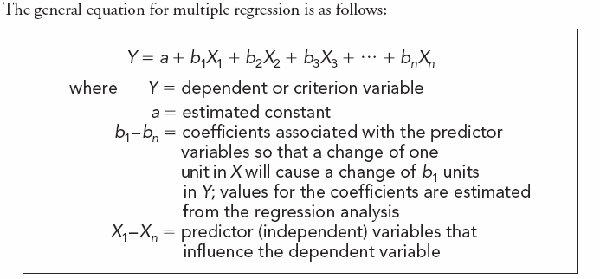
Multiple Regression Analysis
18-5
Key Terms & Definitions

Slide 18
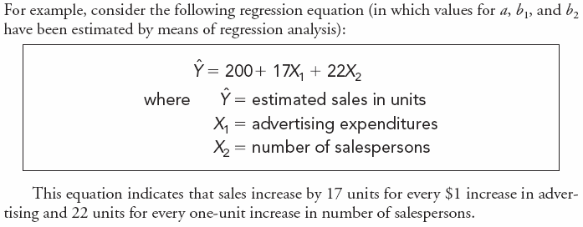
Multiple Regression Analysis
18-6
Key Terms & Definitions

Slide 19
Examples
Suppose a marketer was trying to predict the sales (Y) of a product for a given level of advertising (X₁) and sales person performance (X₂). The resulting output was as follows:
Y = 2,300 + 34(X₁) + 15.5(X₂) with a R² = .12
Given the above results, what would you suggest to the marketer?

Slide 20
Examples
the sales (Y) of a product for a given level of advertising (X₁) and sales person performance (X₂).
Y = 2,300 + 34(X₁) + 15.5(X₂) with a R² = .12
Answer: The resulting regression equation depicts a positive relationship between Sales and both Advertising and Salesperson Performance, which means greater inputs of advertising and higher salesperson performance result in higher sales.
However, the R² is only .12, meaning that only 12% of the variation in the dependent variable Sales (Y) is explained jointly by Advertising (X₁) and Salesperson Performance (X₂).
There must be other performance variables that would explain more of the variation in Sales. The consultant should suggest additional analysis of the company database to find additional variables that would explain more of the variation in Sales.

Slide 21
Coefficient of Determination
17-11
Key Terms & Definitions

Slide 22
Examples
An advertising agency has been doing work for a client selling widgets.
The three-month campaign has produced a low correlation between advertising expenditures and sales for its client.
  Hence, the client is considering firing the ad agency.
The ad agency counters that consumer sales: not a fair assessment of the effectiveness of the ad campaign after only three months.
An analysis of advertising expenditures in relation to
  number of requests for information about the widgets;
  number of distributors stocking widgets;
  number of retailers requesting shipments of widgets.

Slide 23
Examples
What kind of analysis would best assist the ad agency in making their case for the effectiveness of their ad campaign?
A multiple regression analysis.
  requests for information about widgets,
  number of distributors stocking widgets,
  number of retailers requesting shipments of widgets.
  AD Exp. = B₀ + B₁(X₁) + B₂(X₂)+B₃ (X₃)

Slide 24
Multiple Discriminant Analysis
Multiple Discriminant Analysis:
  Procedure for predicting group membership for a (nominal or categorical) dependent variable on the basis of two or more independent variables.
Metric Scale:
  A type of quantitative that provides the most precise measurement.
Nominal or Categorical:
  A type of non-metric qualitative data scale that only uses numbers to indicate membership in a group (e.g., 1=male, 2=female). Most mathematical and statistical procedures cannot be applied to nominal data.
Key Terms & Definitions
18-11

Slide 25
Multiple Discriminant Analysis
Discriminant Score:
  Score that is the basis for predicting to which group a particular object or individual belongs; also called Z score.
Discriminant Coefficient:
  Estimate of the discriminatory power of a particular independent variable; also called discriminant weight.
Classification Matrix:
  A matrix or table that shows the percentages of people or things correctly and incorrectly classified by the discriminant model.
18-12
Key Terms & Definitions

Slide 26
Multiple Discriminant Analysis
Z=a+b1* (current ratio)+b2(Debt ratio)
Fit a discrimination function using historic data.
Plot the equation in the figure.
Companies lie to the left of the line( Z<0 ) are unlikely to go to bankrupt,
Companies lie to the right (Z>0) are likely to go bankrupt.

Slide 27
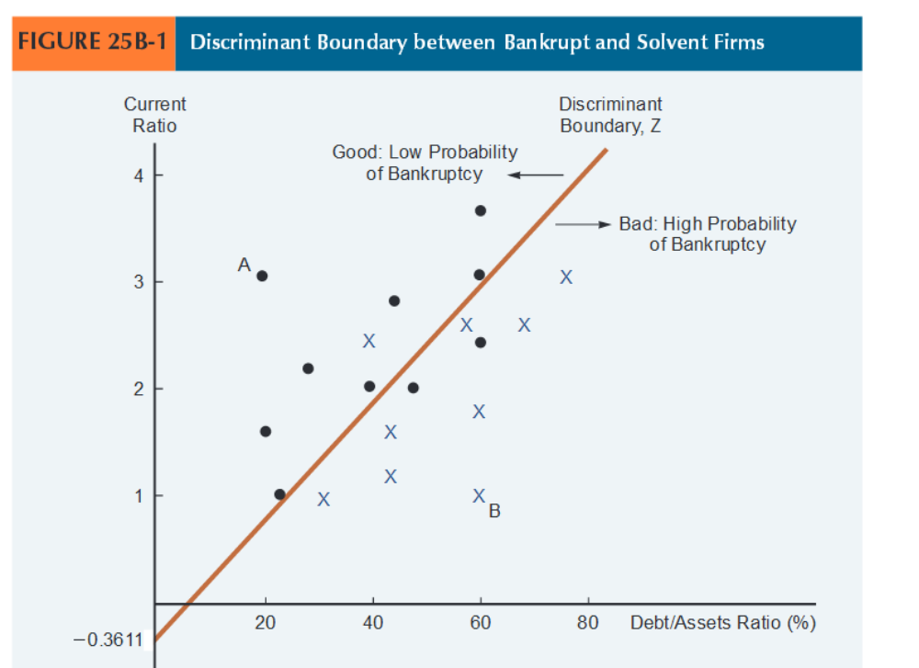
Multiple Discriminant Analysis

Slide 28
Key difference
In the case of multiple regression analysis, the dependent variable must be metric;
In multiple discriminant analysis, the dependent variable is nominal or categorical in nature.

Slide 29
Example
A client has a data set that would be appropriate for a linear model. He wants the resulting model to predict whether or not a person would buy a particular product.
The client has been advised that a multiple regression analysis would be the best approach. What would you suggest?

Slide 30
Example
A client has a data set that would be appropriate for a linear model. He wants the resulting model to predict whether or not a person would buy a particular product. The client has been advised that a multiple regression analysis would be the best approach. What would you suggest?
Ans: Multiple regression analysis would be appropriate if the goal is to predict what sales would be given a set of predictor variables.
However, if the goal was to simply predict whether or not a particular type of purchase behavior would occur, then the proper method would be multiple discriminant analysis.

Slide 31
Cluster Analysis
Cluster analysis
  A multivariate approach for grouping observations based on similarity among measured variables.
    Cluster analysis is an important tool for identifying market segments.
    Cluster analysis classifies individuals or objects into a small number of mutually exclusive and exhaustive groups.
    Objects or individuals are assigned to groups so that there is great similarity within groups and much less similarity between groups.
    The cluster should have high internal (within-cluster) homogeneity and external (between-cluster) heterogeneity.

Slide 32
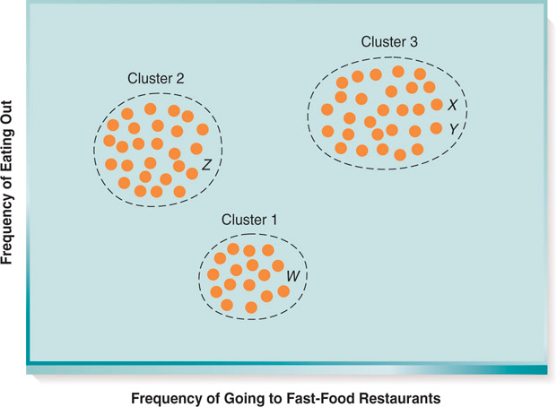
Cluster Analysis
The general term for statistical procedures that classify objects, or people, into some number of mutually exclusive and exhaustive groups on the basis of two or more classification variables.
People who frequently eat out and also frequently eat at fast-food restaurants.
Consumers who frequently eat out but seldom eat at fast-food restaurants.
People who do not frequently eat out or frequently eat at fast-food restaurants.
18-13
Key Terms & Definitions

Slide 33
Examples
An analyst is trying to group together persons who attend theatre performances and who prefer a dinner to accompany the theatre performance. Hence, the two pieces of information are 1) frequency of attending theatre performances and 2) preference for a dinner-theatre format.
What type of analysis should be undertaken to determine if those persons preferring the dinner-theatre format are those who attend theatre performances more frequently?

Slide 34
Examples
An analyst is trying to group together persons who attend theatre performances and who prefer a dinner to accompany the theatre performance.
Hence, the two pieces of information are
  1) frequency of attending theatre performances
  2) preference for a dinner-theatre format.
What type of analysis should be undertaken to determine if those persons preferring the dinner-theatre format are those who attend theatre performances more frequently?

Slide 35
Examples
This problem would be best solved using cluster analysis, which would simultaneously group persons preferring the dinner-theatre format with how frequently they attend theatre performances

Slide 36
Techniques of Cluster Analysis
Which of the following is not an example of a cluster technique?
K-means
Nearest neighbor
Decision trees
BIRCH
All of these are examples

Slide 37
Factor Analysis
Factor: A linear combination of variables that are correlated with each other.
A procedure for simplifying data by reducing a large set of variables to a smaller set of factors of composite variables by identifying dimensions of the data.
18-15
Key Terms & Definitions

Slide 38
Factor Analysis
Data Reduction Technique
  Overlapping information among p variables
For a set of p variables we want to extract a smaller set of n factors that adequately describes the key measures of differentiation
  Uncover the salient underlying dimensions
The correlation matrix
If x1 and x2 are highly correlated the two variables may reflect the same latent construct

Slide 39
Questionnaire to obtain responses regarding the celebrity for a Jewelry Brand
How do you rate the celebrity “ Katrina Kaif “ on the following factors:
Dependable 1 2 3 4 5
Classy 1 2 3 4 5
Beautiful 1 2 3 4 5
Elegant 1 2 3 4 5
Attractive 1 2 3 4 5
……. 1 2 3 4 5

Slide 40
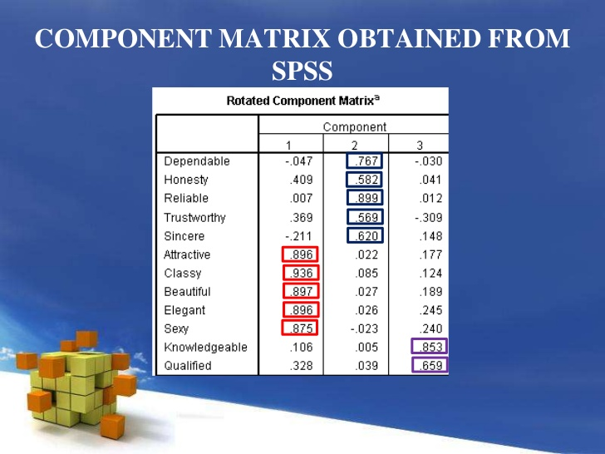

Slide 41
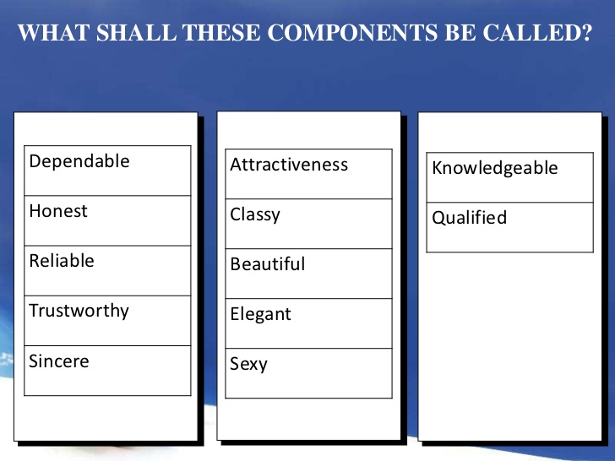

Slide 42
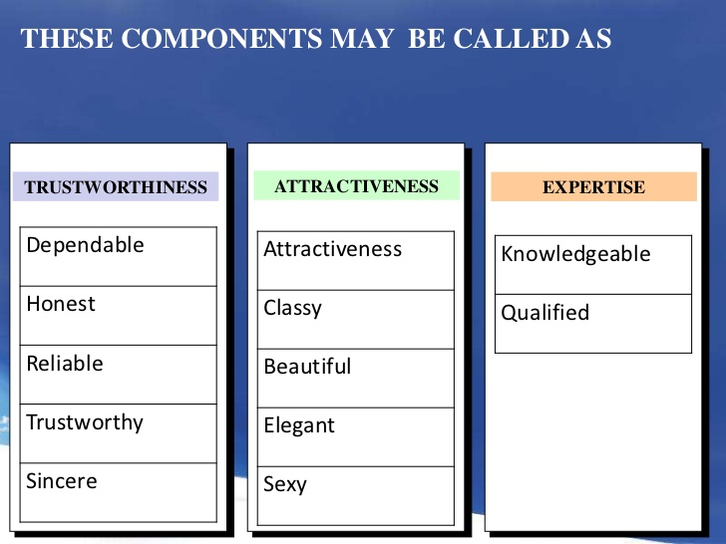

Slide 43
Examples
A client wanted to know which preventive health care information (PHC) sources were related to each other. The following table has factor loadings for 10 types of preventive health care information using a Varimax rotation. Based on the table of results below, what would you tell your client?
Sources of PHC information | Factor 1 | Factor 2 | Factor 3
Web MD | .88 | .15 | .23
Nutritional labels | .11 | .67 | .14
Health fairs | .25 | .32 | .88
Health magazines | .22 | .74 | .30
Health books | .43 | .64 | .31
Hospital seminars | .03 | .21 | .85
Television | .70 | .31 | .34
Wellness center newsletters | .27 | .70 | .20
Medical Encyclopedias | .33 | .76 | .31
Hospital websites | .72 | .42 | .19

Slide 44
Examples
a) Analysis of the factor loadings coupled with the number of factors developed during the principal components step, there are 3 distinct factors or groups of PHC information that co-vary together.
The next step for the analyst would be to examine the factor loadings and assign the individual factors (sources of PHC info) to the composite factor group they are related to.
c)
Factor 1: Electronic and video media
Factor 2: Print Media
Factor 3: Institutional related health events

Slide 45
Question
Independent variables are important components in multiple regression analysis and ________________.
a. multiple discriminant analysis
b. factor analysis
c. conjoint analysis
d. cluster analysis

Slide 46
Question
Cluster analysis is particularly valuable for what type of marketing strategy?
a. product differentiation
b. positioning
c. segmentation
d. cost leadership

